Slide 1
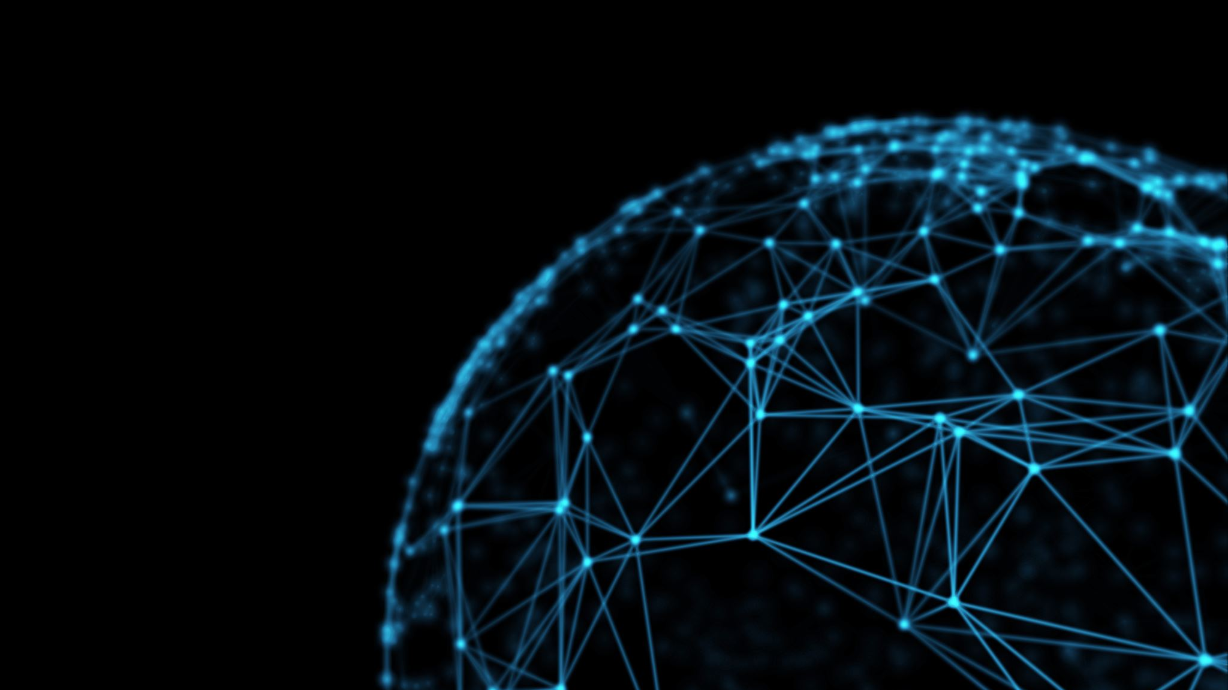
Neural Networks
Cole Zarifis

Slide 2





















$$W^{(1)}$$
$$W^{(2)}$$
$$x_{0}$$
$$a_{0}^{(0)}$$
$$a_{0}^{(1)}$$
$$W^{(k)}$$
$$x_{1}$$
$$a_{1}^{(0)}$$
$$a_{1}^{(1)}$$
$$a_{0}^{(k)}$$
$$y_{0}$$
.
.
.
.
.
.
.
.
.
$$a_{1}^{(k)}$$
$$y_{1}$$
$$x_{n−1}$$
$$a_{n−1}^{(0)}$$
$$a_{n−1}^{(1)}$$
$$a_{3}^{(k)}$$
$$y_{2}$$
$$x_{n}$$
$$a_{n}^{(0)}$$
$$a_{n}^{(1)}$$
Notes:
This is a diagram of a generic feed-forward neural network. It takes in inputs from x1 to xn then there is a transformation done to them within the neuron donated as a, where the subscript is the location within that specific layer and the super script is which layer it is. Then there is the weighted connections that connect each layer together. This diagram is meant to illustrate that there is no specific size that these networks can take. In this example there are only 3 outputs being y1 y2 and y3

Slide 3

What are the components of a neural network?
Inputs
  $x_{1},x_{2},…,x_{n}=\vec{x}$
Outputs
  $y_{1},y_{2},…,y_{n}=\vec{y}$
Weighted connection
  $W^{\left(k\right)}=\left[\begin{matrix}w_{00}^{\left(k\right)} & ⋯ & w_{0j}^{\left(k\right)} \\ ⋮ & ⋱ & ⋮ \\ w_{i0}^{\left(k\right)} & ⋯ & w_{ij}^{\left(k\right)}\end{matrix}\right]$
  $a_{i}^{\left(k−1\right)}$ to $a_{j}^{(k)}$
Notes:
A neural network can be thought of as a really complicated function. It can take in a range of inputs and will give a range of outputs depending on the structure of the network. The inputs can be thought of as a vector as can the outputs. The inputs can take the form of almost any data, as can the outputs. We will get more into the form of the inputs and outputs as we look at different structures of neural networks. Then we have the weights of the neural network where all of the learning takes place. The weights between two layers of the neural network can be represented as a matrix. Where i denotes the location of the neuron in the previous layer and the j represents the next layer in the connection.

Slide 4
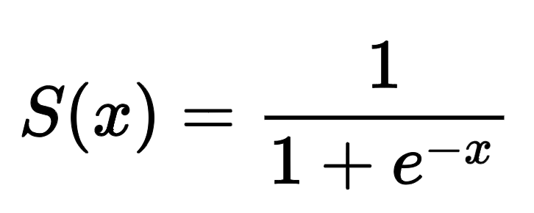
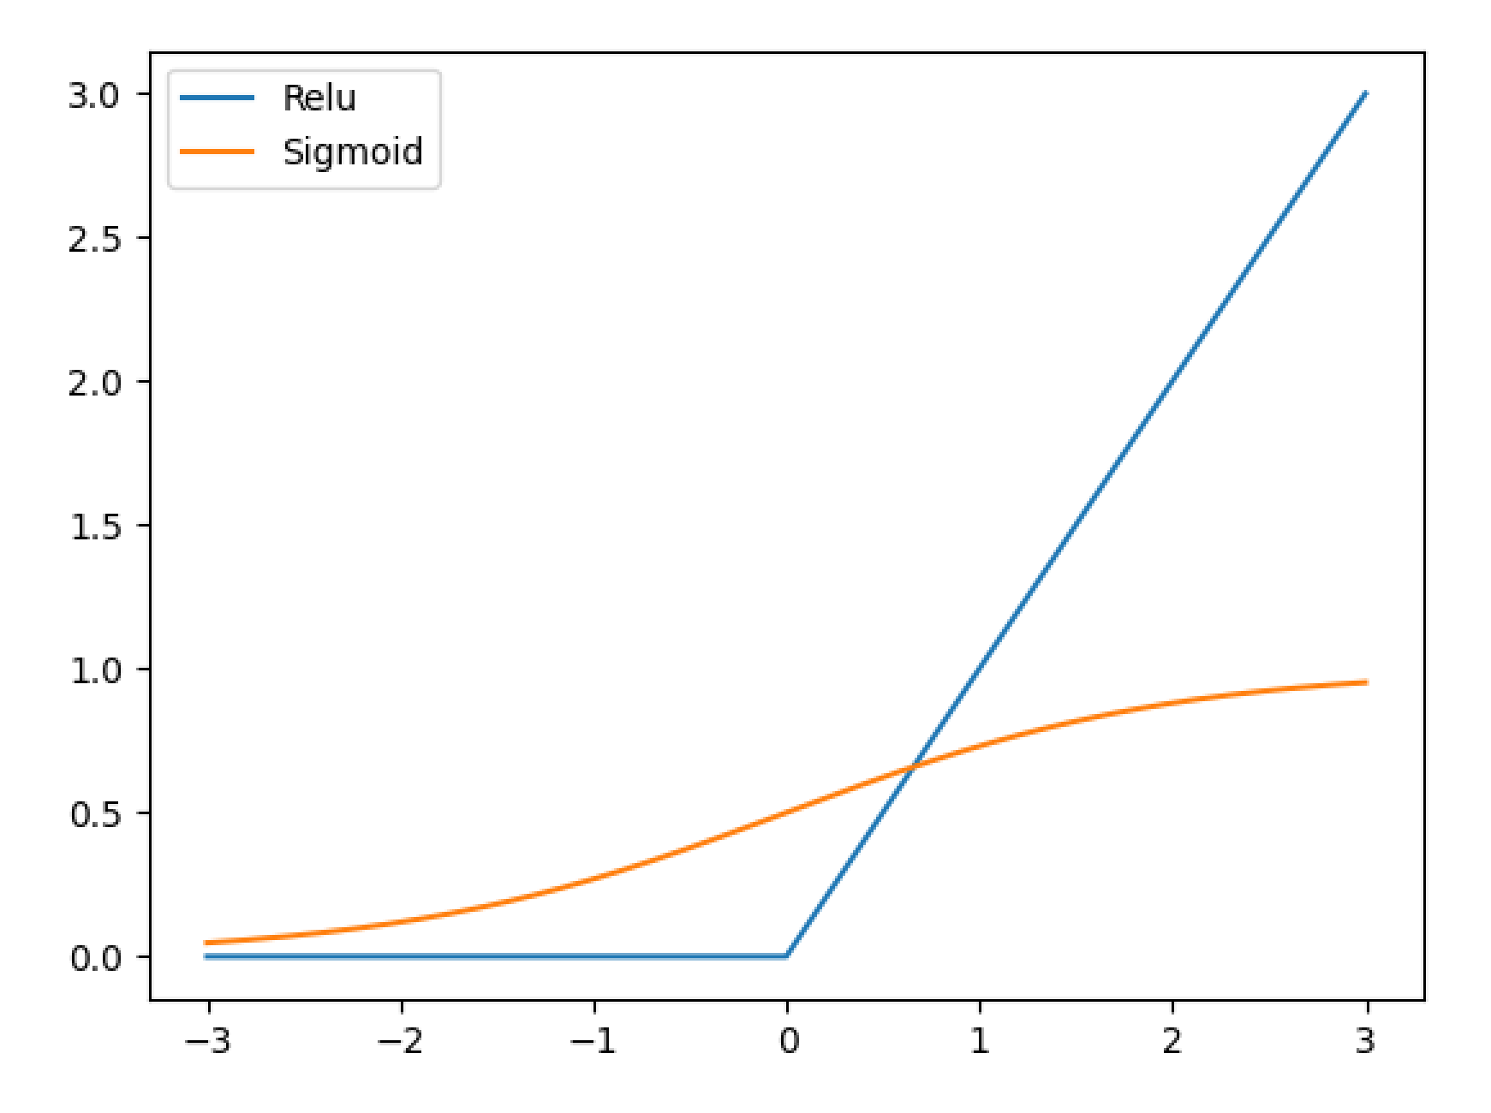
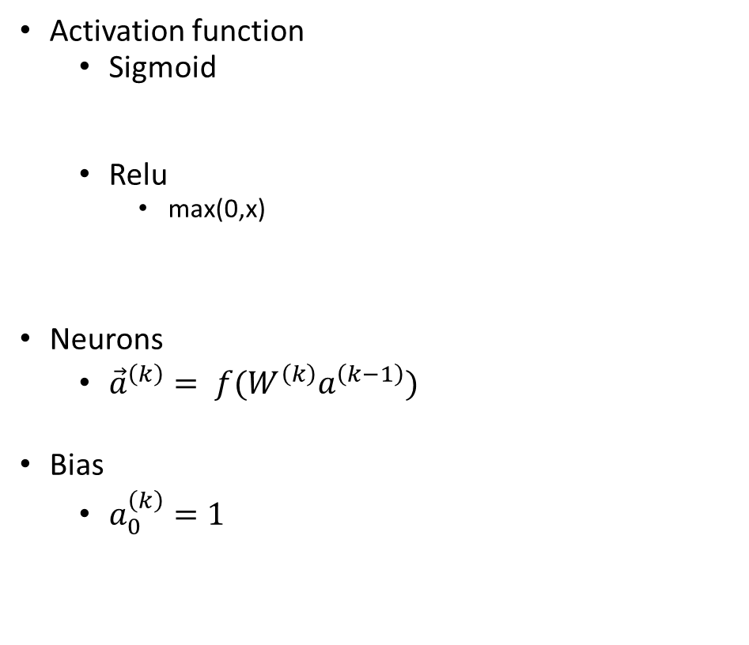
What are the components of a neural network?
Activation function
  Sigmoid
  Relu
    max(0,x)
Neurons
  ${\vec{a}}^{\left(k\right)}= f(W^{\left(k\right)}a^{\left(k−1\right)})$
Bias
  $a_{0}^{\left(k\right)}=1$
Notes:
There is also an activation function that is present in all of the neurons. So the weighted sum of all the connection to that neuron is taken, with the bias being added. This weighted sum goes through a transformation to in a way, normalize the data depending on what you are trying to achieve. This application is using a sigmoid function but reasons for other activation functions will be discussed as we get into different structures. The bias can be thought of a way to describe how important that specific neuron is to that corresponding (maybe go though and get some better explanation of this.

Slide 5
Feed
Forward Neural Network
Uses
  Pattern recognition
  Modeling
  Categorization
Limitations
  overfitting
Notes:
Feed-forward neural networks get its name by the way the information flows. There is a direct path from the input of data to the output because. This kind of structure has a lot of connections which can lead to overfitting of the data.
One of my favorite examples of feed forward neural networks come from a paper published in 2009 where a four layer network was used to model the drying kinetics of pistachio nuts. I love this example because it shows the versatility of neural networks and it can learn based off of almost any information that is provided. The inputs into the network were the air temperature, air velocity used to dry the pistachio nuts and time with the output giving the estimated moisture content of the pistachio. For the hidden layers of the network, they use the sigmoid function to compress the values of the data, while the output layer is just a linear function, meaning it simply takes the sum of all of its inputs as the output. This is because the output value is not a probability, but can be any real number dependending on the units used and how well the pistachio is dried. This network had two hidden layers and the network was trained using 1500 data points, 500 were used for cross validation and 500 were used for testing the network. This network was able to predict the moisture of the pistachios better than all of the previous modeling techniques. I love this example because it shows the versatility of neural networks. The network was able to learn based off of the information it was given.

Slide 6
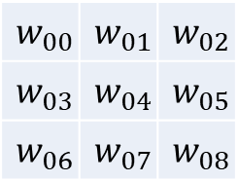
Convolution Layer
Pooling Layer
5
Convolution Layer
A
5
Pooling Layer
1
1
3
3
$$w_{00}$$ | $$w_{01}$$ | $$w_{02}$$
$$w_{03}$$ | $$w_{04}$$ | $$w_{05}$$
$$w_{06}$$ | $$w_{07}$$ | $$w_{08}$$
Notes:
So, convolutional neural networks are meant to solve the problem of over fitting that can happen in a feed forward neural network. CNN are extremely effective in image classification. To go over the structure, the input into the neural network is going to be a matrix of pixels values in this example, we are just going to do grey scale so the values can range from 0-255. There is a kernel, lets say is 5x5, where the kernel will start at the very top left hand side and take the weighted sum of the 5x5 pixels and translate that to the top left of a new image. It will then slide 1 pixel at a time across the entire image recording the weighted sums of the 5x5 grid keeping its location. For each convolution layer there can be multiple kernels giving multiple images. These different kernels are meant to extract different features from the image. Then there is a pooling layer for the network. The two main pooling layers are either max pool or average pool. Where in the diagram, either the average of all of the pixels in the 3x3 kernel is mapped to a new image, or the maximum pixel value in the 3x3 kernel is mapped. Then this level of convolution continues. Repeating this process. So, this convolution is meant to extract features. Then you continue this until you have an output space of a pooling layer which contains images that are 1 pixel. Where this pixel value then can be feed into a feed forward neural network to try and categorize the data. You could take in x_n inputs of the pixel values and then have 26 outputs each representing a different letter in the alphabet you are trying to figure out are in the image.

Slide 7
Loss function
Test the performance of a training example
Notes:
The loss function is used to determine the performance of the network in categorizing the data. So the main point is to have the loss function increase the more wrong the network is. And to decrease the more correct it is. Weigthed binary cross entropy is what I am going to be using. This loss function is used penalize the network for false positive and negatives. So for example we want the output of the network to be 1 and the network outputs .7. So wed take the negative log of .7 multiplied by 1 then multiplied by a weight. The networks answer of .7 can be thought of being 30% confident in the wrong result. And in my example, the second term comes to zero but has the same effect for false positive values.

Slide 8

Stochastic Gradient Descent
The Network is trained using Adam
  Calculated learning rate for each step
Notes:
The network then uses the output of the loss function to update the weights using stochastic gradient descent. For either one training example or a set of training examples, You take the derivate of the loss function with regards to all of the weights within the network. Which the amount that each of the weights changes is determined by a learning rate. But, there is a method that will update the learning rate using the mean and variance of the weight gradient between every step, hopefully giving a more optimal learning rate based on how far along with training the network is

Slide 9
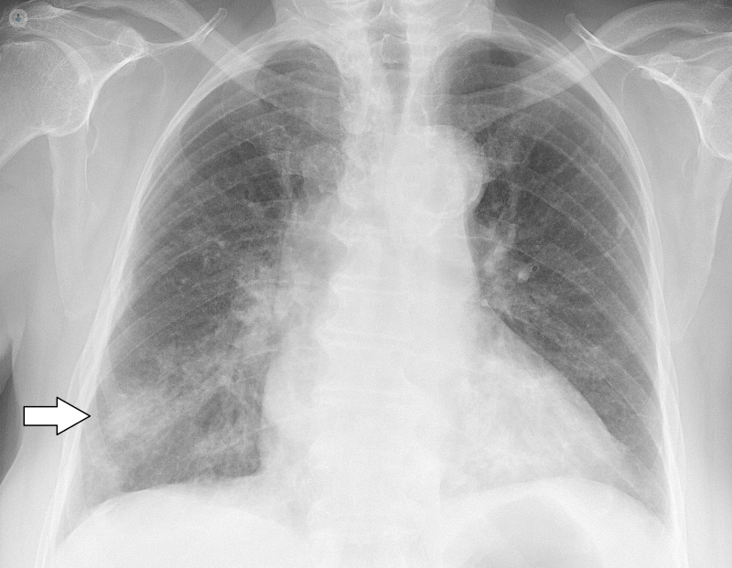
The Data Set
Notes:
So the goal of my project is to build a model for computer assisted diagnosis of chest x ray images.

Slide 10
VinDr-CXR Dataset
15,000 .Dicom images
14 different radio graphic findings
Catch all “No Finding”
Excel Spreadsheet 67,914 rows
Image name
Disease
Radiologist
Bounding box
Etc…
Notes:
The data was curated from 100,000 images collected from the two largest hospitals in Vietnam. All of the images were in .dicom format. Dicom file format has been the standard for transmitting medical images for years. But for my application, I converted them all to .png because a lot of the built in features in tensorflow for networks does not run with dicom images. All of the images have been annoted by a team of 17 radiologists with at least 8 years of experience. Each image has been independently labeled by 3 radiologists. Also, every image can have 1 or more or none of the 14 diseases listed.

Slide 11
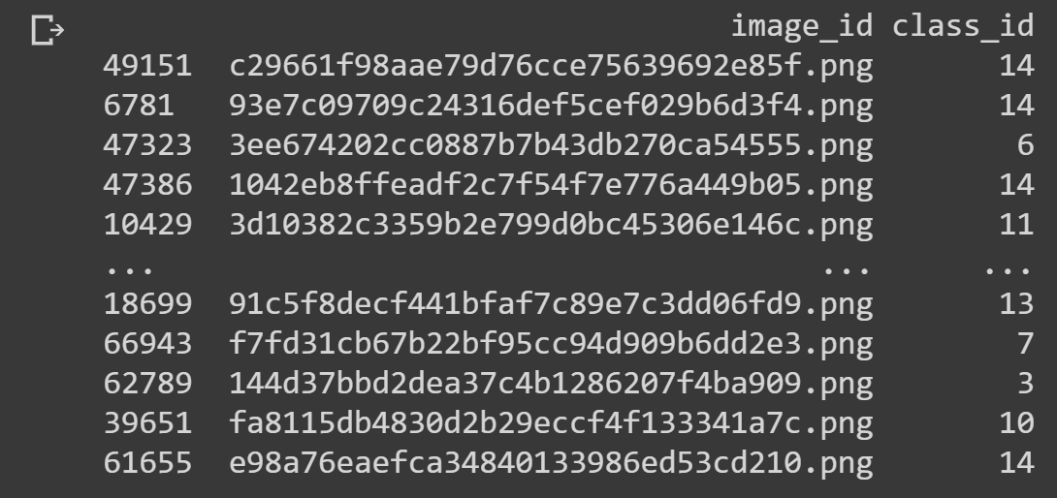
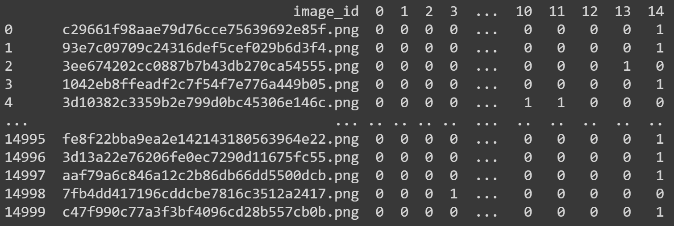
Data Processing
14,000 train / 1,000 test split
Removed unnecessary columns
  Keeping image name and disease categorization
One-Hot-Label
Notes:
For all of my training, I would keep a 14,000 for train and reserved 1,000 for testing. Also, removed some of the columns that were outside the scope of the model I was trying to create. Like radiologist name and bounding box, radiologist id’s and only keeping what I needed which was the disease id and the image name associated with the disease. After trimming, the image on the left is what the data looked like, where we have 67,000 containing 15,000 unique image names but all image names having having multiple different diseases. So I converted it to a one-hot-labeling scheme. Where you see on the right, we have all 15,000 unique images name. And added columns corresponding to the each of the diseases, where a 1 is if the disease is present and a 0 if it is not. This was required because again, there can be multiple disease present in a single image, so one-hot-labeling allows to capture all of the different disease within the image using a single row.

Slide 12
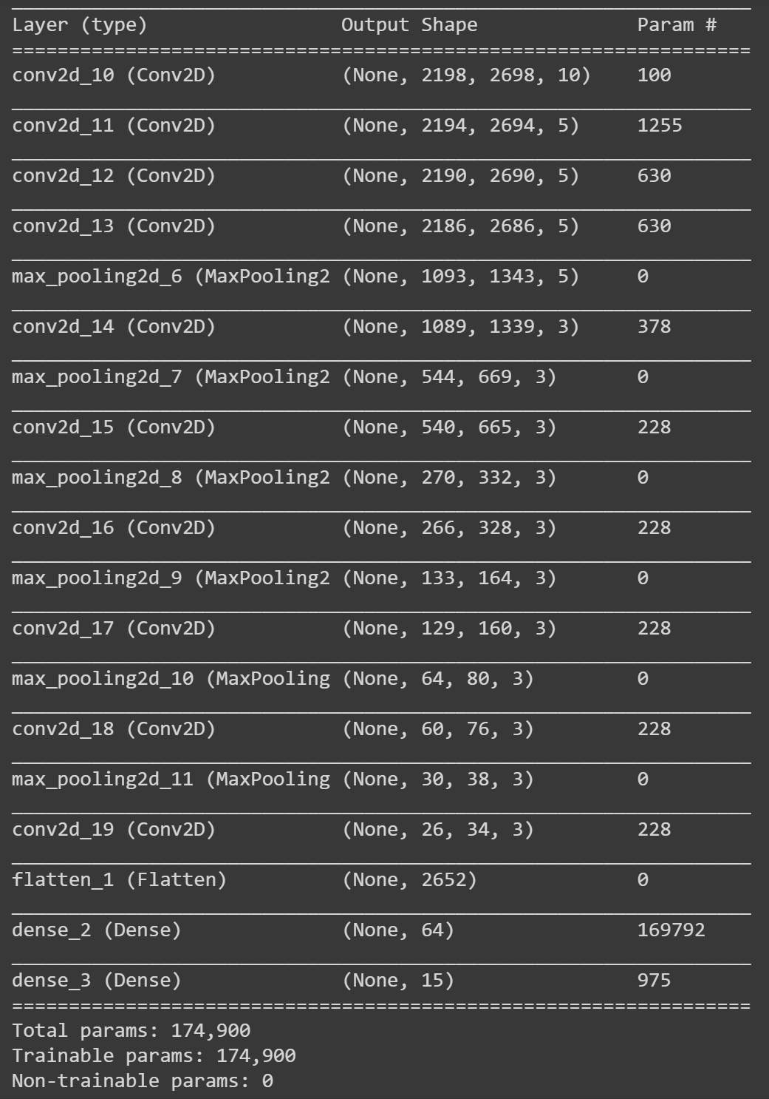
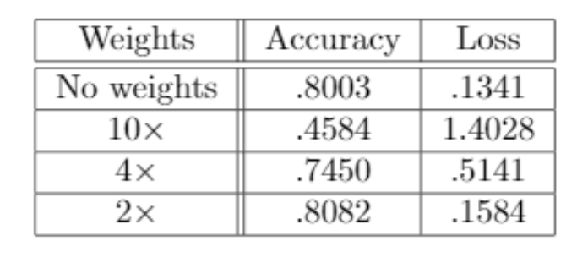
Wrong Approach
Skewed data
  70% in “No Finding”
  7% average for all 14 disease
Notes:
So the data is skewed towards the no finding category, where 70% of the data is found. The average occurrence of all the other 14 categories is 7% where some are more promenet like 20% and other only happen around 1%. So to combat this, I am going to introduce weights into the loss function. Where the loss function will be multiplied by the weights to increasing the loss function much more when the minorty categories are incorrect compared to the no finding category. And by increasing the loss function for the minority categories will hopefully pull the network to specialize in categorizing the less prominent categorizingcorrectly. The goal of this weight analysis is just a proof of concept and will be run on a larger model for better categorization. The 2x weight on all of the minory classes did the best with an accuracy of 80.82% which is much better than expected because randomly guessing would give a network accuracy of 70% all 4 models are exactly the same and were each trained on 10 epochs or 10 iterations of the training data

Slide 13
10, 3x3
Convolutional
3, 5x5
Convolutional
5, 5x5
Convolutional
2,2
Max Pooling
5, 5x5
Convolutional
3, 5x5
Convolutional
5, 5x5
2,2
Convolutional
Max Pooling
2,2
Max Pooling
3, 5x5
Convolutional
3, 5x5
Convolutional
2,2
Max Pooling
2,2
Max Pooling
3, 5x5
Convolutional
3, 5x5
Convolutional
64
Dense
2,2
Max Pooling
15
Output

Slide 14
15,000 x 15 = 225,000
14 diseases
10,606
15,365
No Finding
0 0 0 0 0 0 0 0 0 0 0 0 0 0
1
(225,000 – 15,365) / 225,000 = 93%
Notes:
This is a lie and is actually worse than random. So, if we multiple the number of columns by the number of rows, we get basically the area of responses. Within the 14 minority classes there are only 15,365 labels that are not 0’s and within the ‘no findings’ category there are 10,606 different responses that are not zero. So, if we create a model that spits out 14 0’s and a 1. Or just saying that there is no finding within every single image, the network will perform at an accuracy of 93%. So, 80% is even worse than just being basically random.

Slide 15
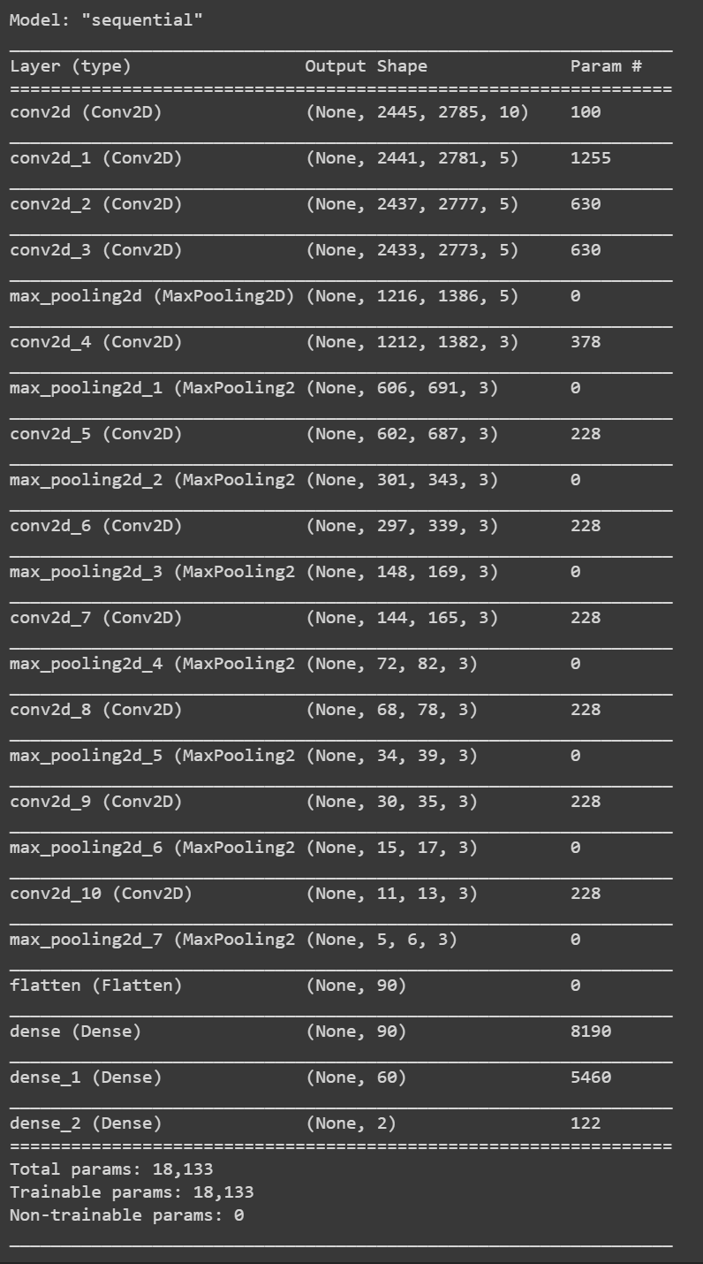
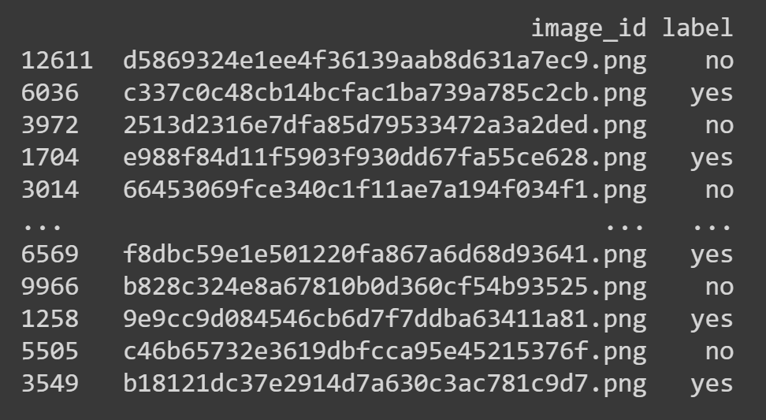
Split Model Approach
Disease or no Disease
  Binary Classifier
Notes:
So, to try and help with this problem, we are going to split up the models. The first model is just going to predict whether there is a disease in the image or not. But, we still have the same issue of 70% of the images are in the “no findings” category. So we will do the weighted model approach with a similar architecture as before, but instead only has two possible outputs. Similarly, this weighted model approach is meant to be a proof of concept

Slide 16
10, 3x3
3, 5x5
Convolutional
Convolutional
2,2
Max Pooling
5, 5x5
Convolutional
3, 5x5
Convolutional
5, 5x5
Convolutional
2,2
Max Pooling
5, 5x5
Convolutional
3, 5x5
Convolutional
2,2
Max Pooling
2,2
Max Pooling
3, 5x5
Convolutional
2,2
3, 5x5
Convolutional
Max Pooling
2,2
Max Pooling
3, 5x5
Convolutional
2,2
90
Dense
Max Pooling
3, 5x5
Convolutional
60
Dense
2,2
2
output
Max Pooling

Slide 17
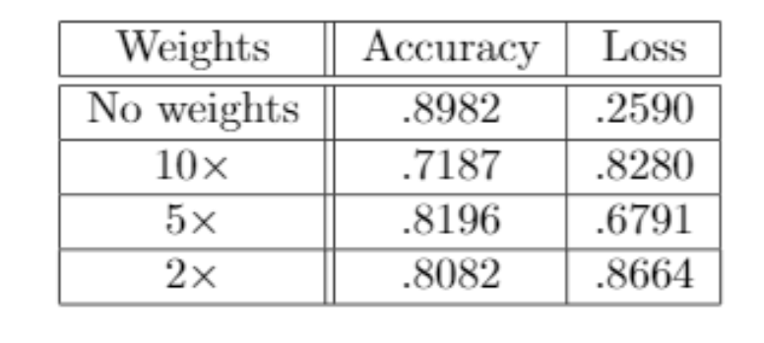
Disease/ No Disease accuracy
Notes:
So by using no weights, the model received an accuracy of about 90% on the training set which in this case, is actually better than randomly guess! This is was excited because this model is able to determine if there is an abnomality within a chest xray!

Slide 18
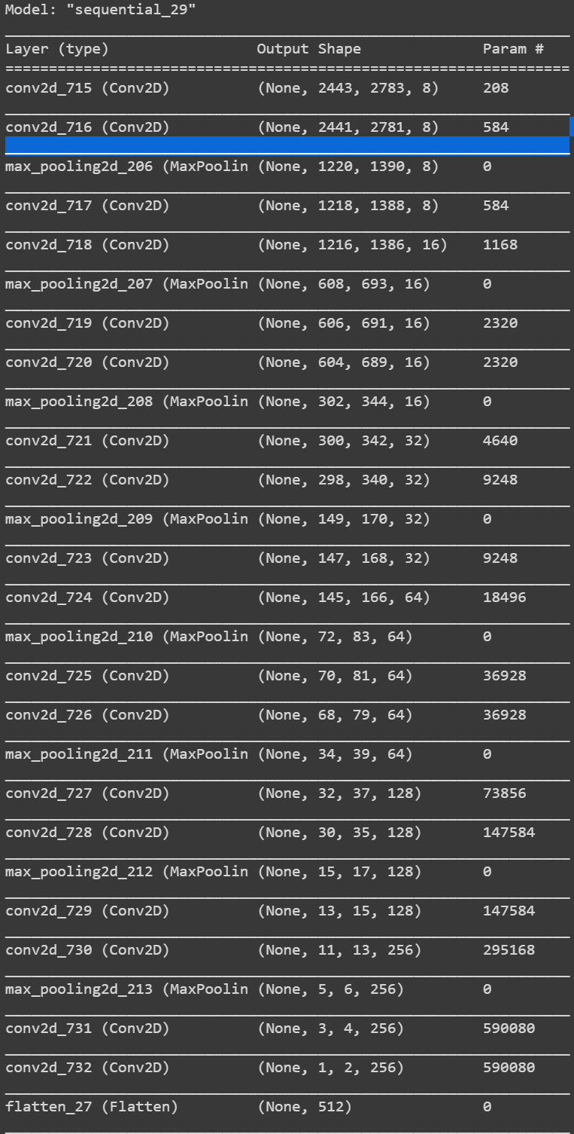
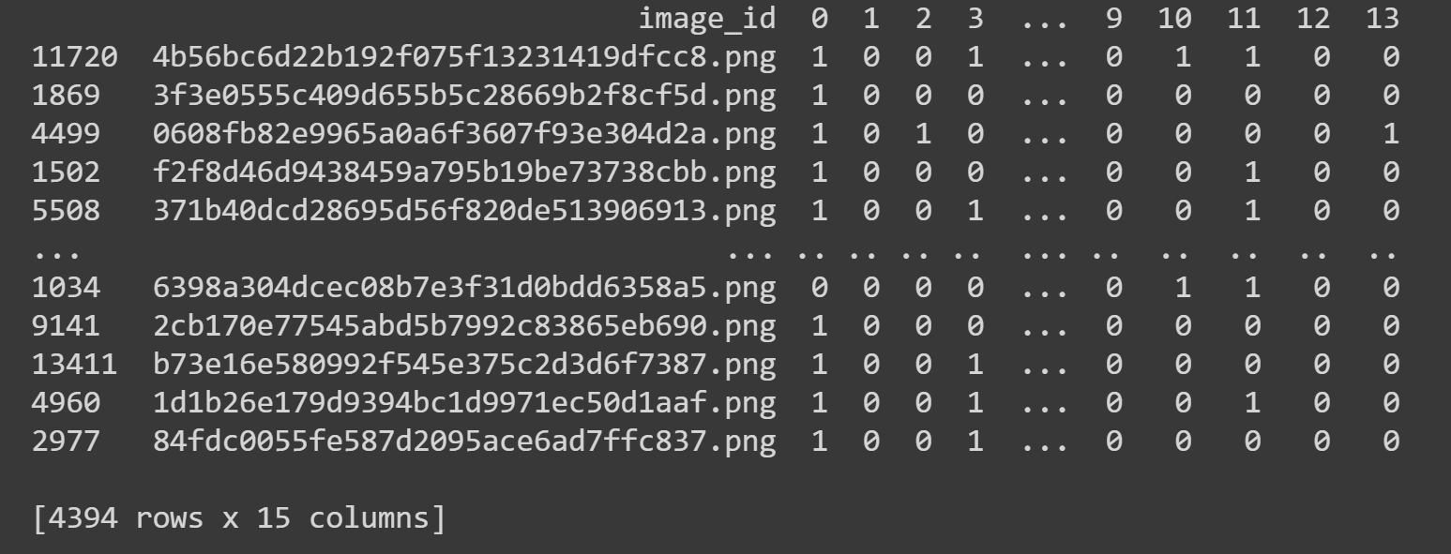
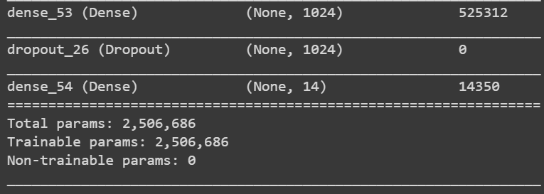
Disease Categorization
Find the disease, given there is one
  70% accuracy
Notes:
Now the goal for this model, is to categorize the disease that is present within the image. So, this model architecture is similar to a paper published in 2015 titled deep residual learning for image recognition and had shown to be the most effective model for disease categorization of chest xray images in a paper published in 2017 “ChestX-ray8: Hospital-scale Chest X-ray Database and Benchmarks on Weakly-Supervised Classification and Localization of Common Thorax Diseases”
Where I did not replicate the model exactly because the images that I am inputting into my network are much larger. Also, In google colab, the exact model was to big to be able to run, So I Scalled it down a big by using less filters and more max pooling layers to reduce the number of weights within the network. One of the big differences in this models architecture compared to the models I was using before is that it increases the number of filters after the size of the image is reduced by half. I roughly modeled this idea, but still need to work on this network, because the accuracy of this model on the training set was at 70% and we have the same issue as before

Slide 19
4,394 x 14 = 61,516
15,365
0 0 0 0 0 0 0 0 0 0 0 0 0 0
(61,516 – 15,365)/61,516 = 75%
Notes:
So with a total amount of observations being 61,516 and there are 15,365 observations that are 1’s. If we create a model that just spits out all 0’s That would receive an accuracy of 75% So, some more work needs to be done for this modeling approach.

Slide 20
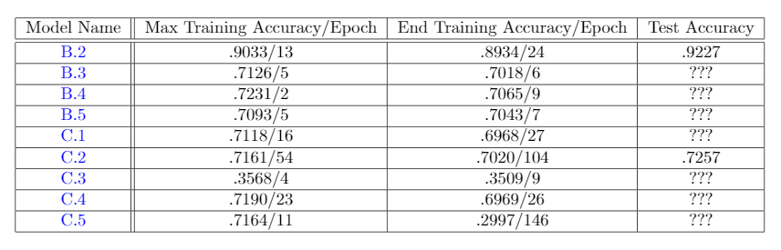
All Models

Slide 21
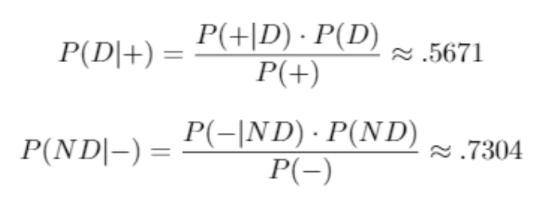
Bayesian Analysis

Slide 22
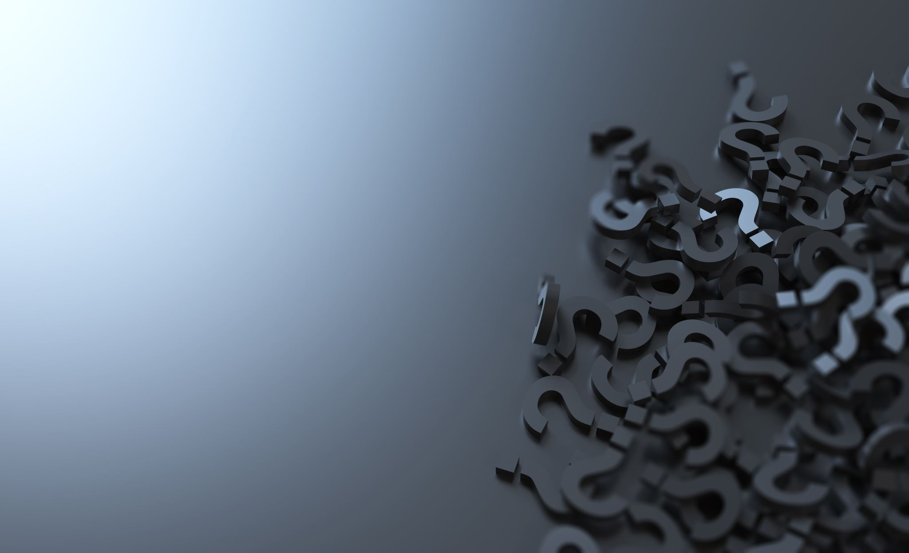
The end
Any Questions?

